Slide 1
Computational Thinking
Jeannette M. Wing
Assistant Director Computer and Information Science and Engineering Directorate National Science Foundation
and
President’s Professor of Computer Science Carnegie Mellon University
University of California Riverside, CA February 17, 2010

Slide 2
My Grand Vision
Computational thinking will be a fundamental skill used by everyone in the world by the middle of the 21st Century.
Just like reading, writing, and arithmetic.
Incestuous: Computing and computers will enable the spread of computational thinking.
In research: scientists, engineers, …, historians, artists
In education: K-12 students and teachers, undergrads, …
J.M. Wing, “Computational Thinking,” CACM Viewpoint, March 2006, pp. 33-35.
Paper off http://www.cs.cmu.edu/~wing/
Notes:
Thinking computationally not programming
Fundamental skill not rote skill
Computing not computers: pervasive computing/computers is passe: 20th Century!
“used by” ambitious. Certainly needed to function in modern society
In research: long-term; in education: nearer-term (outreach, diversity, changing society’s view of our field)

Slide 3
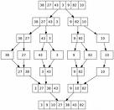
Computing is the Automation of Abstractions
Abstractions
1. Machine
2. Human
Automation
3. Human + Machine
4. Networks of 1, 2, or 3
Computational Thinking focuses on the process of abstraction - choosing the right abstractions - operating in terms of multiple layers of abstraction simultaneously - defining the relationships the between layers
guided by the following concerns…

Slide 4
Computing is the Automation of Abstractions
Abstractions
1. Machine
2. Human
Automation
3. Human + Machine
4. Networks of 1, 2, or 3
Computational Thinking focuses on the process of abstraction - choosing the right abstractions - operating in terms of multiple layers of abstraction simultaneously - defining the relationships the between layers
as in Mathematics
guided by the following concerns…
CT & TC
4
Jeannette M. Wing

Slide 5
Measures of a “Good” Abstraction in C.T.
as in Engineering
Efficiency
How fast?
How much space?
How much power?
Correctness
Does it do the right thing?
Does the program compute the right answer?
Does it do anything?
Does the program eventually produce an answer? [Halting Problem]
-ilities
Simplicity and elegance
Usability
Modifiability
Maintainability
Cost
…
NEW

Slide 6
Computational Thinking, Philosophically
Complements and combines mathematical and engineering thinking
C.T. draws on math as its foundations
But we are constrained by the physics of the underlying machine
C.T. draws on engineering since our systems interact with the real world
But we can build virtual worlds unconstrained by physical reality
Ideas, not artifacts
It’s not just the software and hardware that touch our daily lives, it will be the computational concepts we use to approach living.
It’s for everyone, everywhere

Slide 7
Sample Classes of Computational Abstractions
Algorithms
E.g., mergesort, binary search, string matching, clustering
Data Structures
E.g., sequences, trees, graphs, networks
State Machines
E.g., finite automata, Turing machines
Languages
E.g., regular expressions, …, VDM, Z, …, ML, Haskell, …, Java, Perl
Logics and semantics
E.g., Hoare triples, temporal logic, modal logics, lambda calculus
Heuristics
E.g., A* (best-first graph search), caching
Control Structures
Parallel/sequential composition, iteration, recursion
Communication
E.g., synchronous/asynchronous, broadcast/P2P, RPC, shared memory/message-passing
Architectures
E.g., layered, hierarchical, pipeline, blackboard, feedback loop, client-server, parallel, distributed
…

Slide 8
Examples of Computational Thinking in Other Disciplines

Slide 9
One Discipline, Many Computational Methods

Slide 10
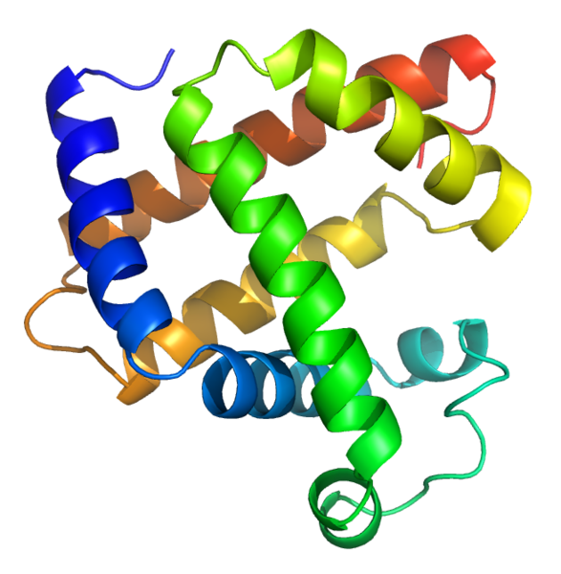
Computational Thinking in Biology
Shotgun algorithm expedites sequencing of human genome
DNA sequences are strings in a language
Boolean networks approximate dynamics of biological networks
Cells as a self-regulatory system are like electronic circuits
Process calculi model interactions among molecules
Statecharts used in developmental genetics
Protein kinetics can be modeled as computational processes
Robot Adam discovers role of 12 genes in yeast
PageRank algorithm inspires ecological food web

Slide 11
Model Checking Primer
Finite State Machine model M
Temporal Logic property Φ
Φ = AG p
M’s computational tree
AF p, EG p, EF p
Model Checker
yes
counterexample
Φ is falsified here.
Notes:
Kripke structure (state machine)
Computational tree generated from it.
CTL \propersubset CTL*
LTL \propersubset CTL*
CTL \inter LTL =/= \emptyset
No CTL formula can express LTL A(FG p) which says along every path, there is some state from which p will hold forever.
No LTL formula can express CTL AG(EF p) which says for every path in every state, there is a path where eventually p is true.
A(FG p) \/ AG(EF p) \in CTL* but not \in CTL and not \in LTL

Slide 12
Model Checking Problem
Let M be a finite state machine.
Let Φ be a specification in temporal logic.
Find all states s of M such that:
M, s |= Φ
Efficient algorithms: [CE81, CES86, Ku94, QS81, VW94]
Efficient data structures: binary decision diagrams [Br86]

Slide 13
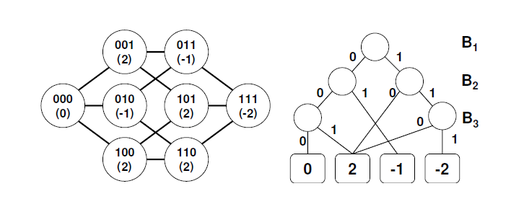
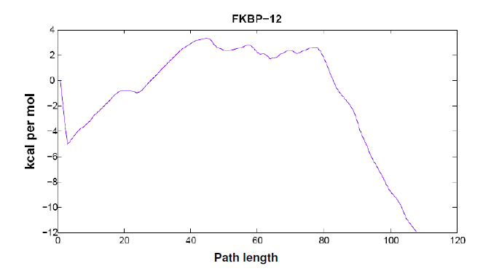
Model Checking in Biology
Goal: Predict Rate of Folding of Proteins
1. Finite State Machine M represents 3-residue protein
1’. BDD efficiently represents M
2. Temporal Logic Formula Φ a. Will the protein end up in a particular configuration? b. Will the second residue fold before the first one? c. Will the protein fold within t ms? d. What is the probability that (c)?
e. Does the state s have k folded residues and have energy c?
Method easily handles proteins up to 76 residues.
Model checking can explore
state spaces as large as 2^{76 ≈} 10²³, 14 orders of magnitude greater than comparable techniques [LJ07].
Energy Profile for FKBP-12, Computed via Method
Notes:
000 corresponds to the 3-residue protein in a completely unfolded state; 111, folded state. Other states represent partial foldings of the protein. A transition from a pair of states is allowed if for the bit vector representation of those state the Hamming distance is small
The numbers in parentheses represent a state’s free energy (Equation 1 of [LJ07]).
The protein’s energy landscape is the function that maps each configuration to its energy.
The BDD efficiently represents all configurations that have the same energy (leaf nodes).
Computationally, the task is to find a low-energy path (or set of paths) from the Unfolded state (as represented by the bit vector 000) to the Folded state (111).
Results: Tried it on 19 proteins with state spaces as large as 2^76 = 10^23, limited only by 2GB memory on a single processor.
For proteins up to 74 residues, the longest running time was under 30 minutes. (Cost goes into constructing BDD).
With approximate model checking, can do proteins of 2^107 = 10^32 state.s.
Correlation coefficient between predicted folding rates and experimental is 0.87, better than any other comparable technique. Also smaller mean absolute error.

Slide 14
One Computational Method,
Many Disciplines
Machine Learning has transformed the field of Statistics.

Slide 15

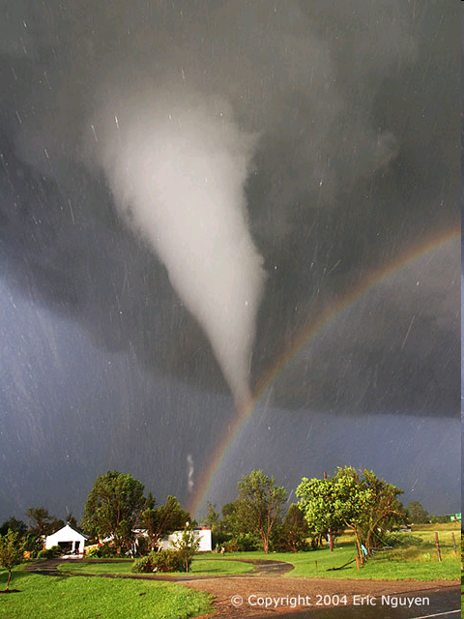

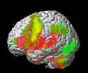
Machine Learning in the Sciences
Astronomy
- Brown dwarfs and fossil galaxies discovery via machine learning, data mining, data federation - Very large multi-dimensional datasets analysis using KD-trees
Credit: SDSS
Medicine
- Anti-inflammatory drugs - Chronic hepatitis - Mammograms - Renal and respiratory failure
Credit: LiveScience
Meteorology
- Tornado formation
Neurosciences
Credit: Eric Nguyen, Oklahoma University
- fMRI data analysis to understand language via machine learning

Slide 16






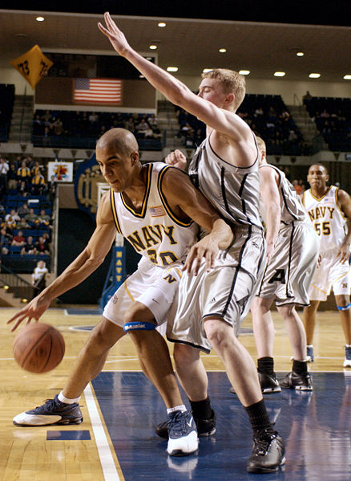





Machine Learning Everywhere
Supermarkets
Credit Cards
Wall Street
Credit: Wikipedia
Entertainment: Shopping, Music, Travel
Sports
Credit: Wikipedia

Slide 17
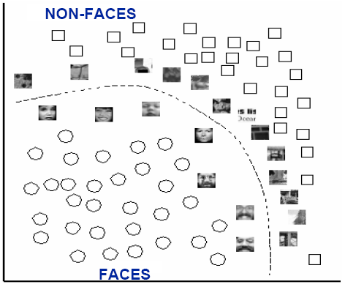
Notes:
17
One kind of machine learning task is to classify or cluster data points. In this learning problem, given a set of input-output values, the machine is expected to learn (approximately) the general function. Here we have a set of points, some labeled as faces and others as non-faces. If we can learn what is a face or not, then for any new image that we process then we can classify it automatically.

Slide 18
?
Notes:
18
Here is an abstract representation of the same problem.

Slide 19
Notes:
19
Of course in general the function is not so obviously a “straight line” in two dimensions, but likely a curve in two dimensions or a surface in three dimensions, and more generally hyperplanes for n dimensions

Slide 20
Question (Kearns): Can a Set of Weak Learners Create a Single Strong One?
Answer: Yes, by Boosting Algorithms (e.g., [FS99])
Notes:
20
One of the exciting developments in machine learning addressed this question:
A weak learner is defined to be a classifier which is only slightly correlated with the true classification. In contrast, a strong learner is a classifier that is arbitrarily well-correlated with the true classification.
The affirmative answer has had significant ramifications to the fields of machine learning and statistics. Here is a hint of how boosting works.
We are given a set of labeled points and want to find a classifier separating the blue crosses from the red dashes.

Slide 21
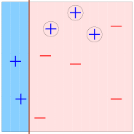
Notes:
21
Initially we choose a classifier and run through all the points: putting the blue crosses in the blue and red dashes in the pink. For any points is gets wrong, we BOOST its importance, shown here by the enlargened blue crosses in the pink.

Slide 22
Notes:
22
We iterate.

Slide 23
Notes:
23
Yet another “weak” classifier. Here we boost the red dashes in the blue.

Slide 24
Notes:
24
Iterate again

Slide 25
Notes:
25

Slide 26
Notes:
26
We have three weak classifiers, which we can combine into a strong classifier.

Slide 27
Notes:
27
In short, boosting is an procedure of iteratively learning weak classifiers with respect to a distribution and combining them to construct a strong classifier.
The applications have been many and wide ranging, from using boosting for tumor classification with gene expression data to ranking movie recommendations.
You can download software packages that implement many variations of these boosting algorithms.

Slide 28
Computational Thinking in the Sciences and Beyond

Slide 29
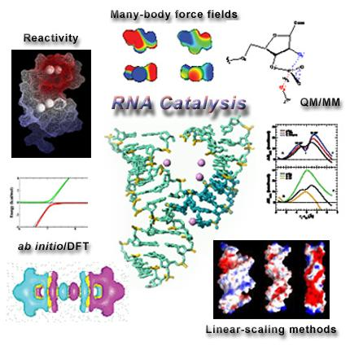
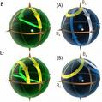

CT in Other Sciences
- Atomistic calculations are used to explore chemical phenomena
Optimization and searching algorithms identify best chemicals for improving reaction conditions to improve yields
Chemistry
Physics
[York, Minnesota]
- Adiabatic quantum computing: How quickly is convergence? - Genetic algorithms discover laws of physics.
Credit: NASA
Geosciences
Credit: Oxford University
- Abstractions for Sky, Sea, Ice, Land, Life, People, etc. - Hierarchical, composable , modular, traceability, allowing multiple projections along any dimension, data element, or query
- Well-defined interfaces

Slide 30

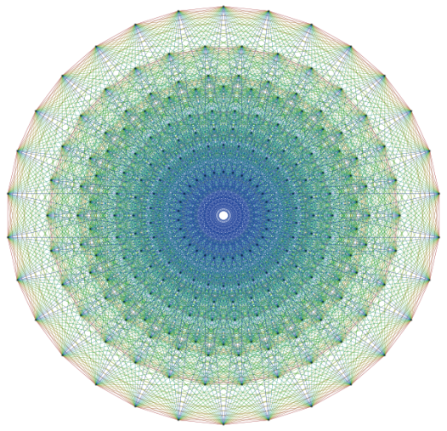
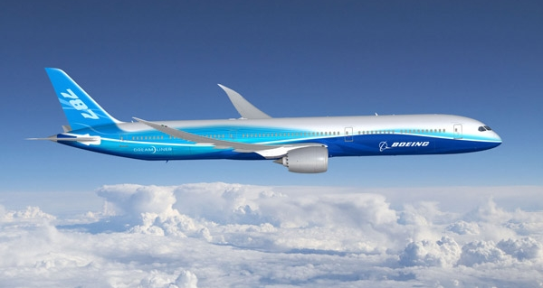
CT in Math and Engineering
Mathematics
- Discovering E8 Lie Group: 18 mathematicians, 4 years and 77 hours of supercomputer time (200 billion numbers). Profound implications for physics (string theory) - Four-color theorem proof
Credit: Wikipedia
Credit: Wikipedia
Engineering (electrical, civil, mechanical, aero & astro,…)
Credit: Boeing
- Calculating higher order terms implies more precision, which implies reducing weight, waste, costs in fabrication - Boeing 777 tested via computer simulation alone, not in a wind tunnel

Slide 31




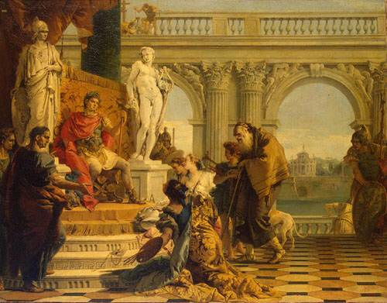
CT for Society
Economics
- Automated mechanism design underlies electronic commerce, e.g., ad placement, on-line auctions, kidney exchange - Internet marketplace requires revisiting Nash equilibria model
- Use intractability for voting schemes to circumvent impossibility results
- Inventions discovered through automated search are patentable
- Stanford CL approaches include AI, temporal logic, state machines, process algebras, Petri nets - POIROT Project on fraud investigation is creating a detailed ontology of European law - Sherlock Project on crime scene investigation
Law
Humanities
- Digging into Data Challenge: What could you do with a million books? Nat’l Endowment for the Humanities (US), JISC (UK), SSHRC (Canada) - Music, English, Art, Design, Photography, …
Notes:
Main impossibility result is the Gibbard-Satterthwaite theorem that says that any voting mechanism is either manipulable or dictatorial
Conitzer and Sandholm can design voting mechanisms where finding a beneficial manipulation is computationally intractable

Slide 32
Educational Implications

Slide 33
Pre-K to Grey
K-6, 7-9, 10-12
Undergraduate courses
Freshmen year
“Ways to Think Like a Computer Scientist” aka Principles of Computing
Upper-level courses
Graduate-level courses
Computational arts and sciences
E.g., entertainment technology, computational linguistics, …, computational finance, …, computational biology, computational astrophysics
Post-graduate
Executive and continuing education, senior citizens
Teachers, not just students

Slide 34
Education Implications for K-12
Question and Challenge for the Computing Community:
What is an effective way of learning (teaching) computational thinking by (to) K-12?
- What concepts can students (educators) best learn (teach) when?
What is our analogy to numbers in K, algebra in 7, and calculus in 12?
- We uniquely also should ask how best to integrate The Computer with teaching the concepts.
Computer scientists are now working with educators and cognitive learning scientists to address these questions.

Slide 35
Computational Thinking in Daily Life

Slide 36
Getting Morning Coffee at the Cafeteria
straws, stirrers, milk
coffee
soda
cups
sugar, creamers
lids
napkins

Slide 37
Getting Morning Coffee at the Cafeteria
straws, stirrers, milk
coffee
soda
cups
sugar, creamers
lids
napkins
Especially Inefficient With Two or More Persons…

Slide 38
Better: Think Computationally—Pipelining!
straws, stirrers, milk
coffee
soda
cups
sugar, creamers
lids
napkins

Slide 39
Computational Thinking at NSF

Slide 40
CDI: Cyber-Enabled Discovery and Innovation
Paradigm shift
Not just computing’s metal tools (transistors and wires) but also our mental tools (abstractions and methods)
It’s about partnerships and transformative research.
To innovate in/innovatively use computational thinking; and
To advance more than one science/engineering discipline.
Investments by all directorates and offices
FY08: $48M, 1800 Letters of Intent, 1300 Preliminary Proposals, 200 Full Proposals, 36 Awards
FY09: $63M+, 830 Prelimary Proposals, 283 Full Proposals, 53+ Awards
Computational Thinking for Science and Engineering
Notes:
~650 Data to Knowledge, 500 Understanding Complexity, < 200 Virtual Organizations
90 PDs (~35 from CISE) and 6 (4 from CISE) admin staff across the agency helped

Slide 41
Range of Disciplines in CDI Awards
Aerospace engineering
Astrophysics and cosmology
Atmospheric sciences
Biochemistry
Biomaterials
Biophysics
Chemical engineering
Civil engineering
Communications science and engineering
Computer science
Cosmology
Ecosystems
Genomics
Geosciences
Linguistics
Materials engineering
Mathematics
Mechanical engineering
Molecular biology
Nanocomputing
Neuroscience
Proteomics
Robotics
Social sciences
Statistics
Statistical physics
Sustainability
…
… advances via Computational Thinking

Slide 42
Range of Societal Issues Addressed
Cancer therapy
Climate change
Environment
Sustainability
Visually impaired
Water

Slide 43
C.T. in Education: National Efforts
ACM-Ed
Computing Community
CRA-E
CSTA
NSF
College Board
Rebooting
Computational Thinking
National Academies
workshops
CSTB “CT for Everyone” Steering Committee
Marcia Linn, Berkeley
Al Aho, Columbia
Brian Blake, Georgetown
Bob Constable, Cornell
Yasmin Kafai, U Penn
Janet Kolodner, Georgia Tech
Larry Snyder, U Washington
Uri Wilensky, Northwestern
K-12
BPC
CPATH
AP

Slide 44
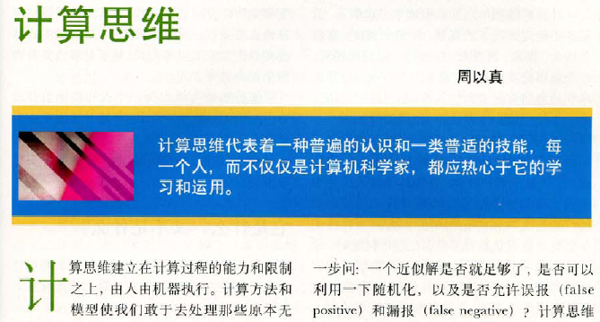
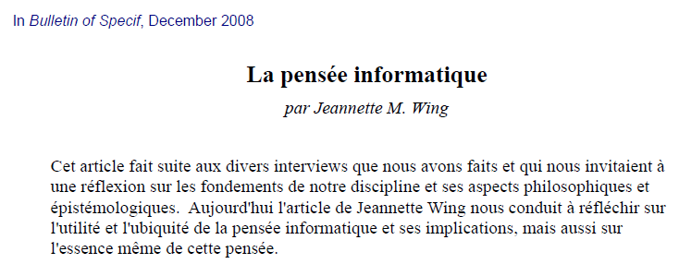
Computational Thinking, International
UK Research Assessment (2009)
The Computer Science and Informatics panel said “Computational thinking is influencing all disciplines….”

Slide 45
Spread the Word
Help make computational thinking commonplace!
To fellow faculty, students, researchers, administrators, teachers, parents, principals, guidance counselors, school boards, teachers’ unions, congressmen, policy makers, …
Notes:
Thinking computationally not programming
Fundamental skill not rote skill
Computing not computers: pervasive computing/computers is passe: 20th Century!
“used by” ambitious. Certainly needed to function in modern society
In research: long-term; in education: nearer-term (outreach, diversity, changing society’s view of our field)

Slide 46
Thank you!

Slide 47
References (Representative Only)
Computational Thinking
University of Edinburgh, http://www.inf.ed.ac.uk/research/programmes/comp-think/
[Wing06] J.M. Wing, “Computational Thinking,” CACM Viewpoint, March 2006, pp. 33-35, http://www.cs.cmu.edu/~wing/
Model Checking, Temporal Logic, Binary Decisions Diagrams
[Br86] Randal Bryant, “Graph-Based Algorithms for Boolean Function Manipulation,” IEEE Trans. Computers, 35(8): 677-691 (1986).
[CE81] E. M. Clarke and E. A. Emerson, “The Design and Synthesis of Synchronization Skeletons Using Temporal Logic,” Proceedings of the Workshop on Logics of Programs, IBM Watson Research Center, Yorktown Heights, New York, Springer-Verlag Lecture Notes in Computer Science, #131, pp. 52–71, May 1981.
[CES86] E. M. Clarke, E. A. Emerson, and A. P. Sistla, “Automatic Verification of Finite State Concurrent Systems Using Temporal Logic Specifications,” ACM Trans. Prog. Lang. and Sys., (8)2, pp. 244-263, 1986.
[CGP99] Edmund M. Clarke, Jr., Orna Grumberg and Doron A. Peled, Model Checking, MIT Press, 1999, ISBN 0-262-03270-8.
[Ku94] Robert P. Kurshan, Computer Aided Verification of Coordinating Processes: An Automata-theoretic Approach, Princeton Univ. Press, 1994.
[Pn77] Amir Pnueli, “The Temporal Logic of Programs,” Foundations of Computer Science, FOCS, pp. 46-57, 1977.
[QS82] Jean-Pierre Queille, Joseph Sifakis, “Specification and verification of concurrent systems in CESAR,” Symposium on Programming, Springer LNCS #137 1982: 337-351.
[VW86] Moshe Y. Vardi and Pierre Wolper, “An Automata-Theoretic Approach to Automatic Program Verification (Preliminary Report),” Logic in Computer Science, LICS 1986: 332-344.
Computational Thinking and Biology
Allessina and Pascual, “Googling Food Webs: Can an Eigenvector Measure Species' Importance for Coextinctions?”, PLoS Computational Biology, 5(9), September 4, 2009. http://www.ploscompbiol.org/article/info:doi%2F10.1371%2Fjournal.pcbi.1000494
Executable Cell Biology, Jasmin Fisher and Thomas A Henzinger, Nature Biotechnology, Vol. 25, No. 11, November 2007. (See paper for many other excellent references.)
[LJ07] Predicting Protein Folding Kinetics via Temporal Logic Model Checking, Christopher Langmead and Sumit Jha, WABI, 2007.
Systems Biology Group, Ziv Bar-Joseph, Carnegie Mellon University, http://www.sb.cs.cmu.edu/pages/publications.html

Slide 48
References (Representative Only)
Machine Learning and Applications
Christopher Bishop, Pattern Recognition and Machine Learning, Springer, 2006.
[FS99] Yoav Freund and Robert E. Schapire, “A short introduction to boosting.” Journal of Japanese Society for Artificial Intelligence, 14(5):771-780, September, 1999.
Tom Mitchell, Machine Learning, McGraw Hill, 1997
Symbolic Aggregate Approximation, Eamonn Keogh, UC Riverside, http://www.cs.ucr.edu/~eamonn/SAX.htm (applications in Medical, Meteorological and many other domains)
The Auton Lab, Artur Dubrawski, Jeff Schneider, Andrew Moore, Carnegie Mellon, http://www.autonlab.org/autonweb/2.html (applications in Astronomy, Finance, Forensics, Medical and many other domains)
Computational Thinking and Astronomy
J. Gray, A.S. Szalay, A. Thakar, P. Kunszt, C. Stoughton, D. Slutz, J. vandenBerg, “Data Mining the SDSS SkyServer Database,” in Distributed Data & Structures 4: Records of the 4th International Meeting, W. Litwin, G. Levy (eds), Paris France March 2002, Carleton Scientific 2003, ISBN 1-894145-13-5, pp 189-210.
Sloan Digital Sky Survey @Johns Hopkins University, http://www.sdss.jhu.edu/
Computational Thinking and Chemistry
[Ma07] Paul Madden, Computation and Computational Thinking in Chemistry, February 28, 2007 talk off http://www.inf.ed.ac.uk/research/programmes/comp-think/previous.html
Computational Thinking and Economics
Abraham, D., Blum, A. and Sandholm, T., “Clearing algorithms for barter exchange markets: enabling nationwide kidney exchanges,“ Proc. 8th ACM Conf. on Electronic Commerce, pp. 295–304. New York, NY: Association for Computing Machinery, 2007.
Conitzer, V., Sandholm, T., and Lang, J., When Are Elections with Few Candidates Hard to Manipulate? Journal of the ACM, 54(3), June 2007.
Conitzer, V. and Sandholm, T., Universal Voting Protocol Tweaks to Make Manipulation Hard. In Proceedings of the International Joint Conference on Artificial Intelligence (IJCAI), 2003.
Michael Kearns, Computational Game Theory, Economics, and Multi-Agent Systems, University of Pennsylvania, http://www.cis.upenn.edu/~mkearns/#gamepapers
Algorithmic Game Theory, edited by Noam Nisan, Tim Roughgarden, Eva Tardos, and Vijay V. Vazirani, September 2007, http://www.cambridge.org/us/catalogue/catalogue.asp?isbn=9780521872829
David Pennock, Yahoo! Research, Algorithmic Economics, http://research.yahoo.com/ksc/Algorithmic_Economics

Slide 49
References (Representative Only)
Computational Thinking and Law
The Poirot Project, http://www.ffpoirot.org/
Robert Plotkin, Esq., The Genie in the Machine: How Computer-Automated Inventing is Revolutionizing Law and Business, forthcoming from Stanford University Press, April 2009, Available from www.geniemachine.com
Burkhard Schafer, Computational Legal Theory, http://www.law.ed.ac.uk/staff/burkhardschafer_69.aspx
Stanford Computational Law, http://complaw.stanford.edu/
Computational Thinking and Medicine
The Diamond Project, Intel Research Pittsburgh, http://techresearch.intel.com/articles/Tera-Scale/1496.htm
Institute for Computational Medicine, Johns Hopkins University, http://www.icm.jhu.edu/
See also Symbolic Aggregate Approximation, Eamonn Keogh, UC Riverside, http://www.cs.ucr.edu/~eamonn/SAX.htm
Computational Thinking and Meteorology
Yubin Yang, Hui Lin, Zhongyang Guo, Jixi Jiang, “A data mining approach for heavy rainfall forecasting based on satellite image sequence analysisSource,” Computers and Geosciences, Volume 33 , Issue 1, January 2007, pp. 20-30, ISSN:0098-3004.
See also Symbolic Aggregate Approximation, Eamonn Keogh, UC Riverside, http://www.cs.ucr.edu/~eamonn/SAX.htm
Computational Thinking (especially Machine Learning) and Neuroscience
Yong Fan, Dinggang Shen, Davatzikos, C., “Detecting Cognitive States from fMRI Images by Machine Learning and Multivariate Classification,” Computer Vision and Pattern Recognition Workshop, 2006. CVPRW '06, June 2006, p. 89.
T.M. Mitchell, R. Hutchinson, R.S. Niculescu, F.Pereira, X. Wang, M. Just, and S. Newman, "Learning to Decode Cognitive States from Brain Images,"Machine Learning, Vol. 57, Issue 1-2, pp. 145-175. October 2004.
X. Wang, R. Hutchinson, and T. M. Mitchell, "Training fMRI Classifiers to Detect Cognitive States across Multiple Human Subjects ," Neural Information Processing Systems 2003. December 2003.
T. Mitchell, R. Hutchinson, M. Just, R.S. Niculescu, F. Pereira, X. Wang, "Classifying Instantaneous Cognitive States from fMRI Data," American Medical Informatics Association Symposium, October 2003.
Dmitri Samaras, Image Analysis Lab, http://www.cs.sunysb.edu/~ial/brain.html
Singh, Vishwajeet and Miyapuram, K. P. and Bapi, Raju S., “Detection of Cognitive States from fMRI data using Machine Learning Techniques,” IJCAI, 2007.
Computational Thinking and Sports
Synergy Sports analyzes NBA videos, http://broadcastengineering.com/news/video-data-dissect-basketball-0608/
Lance Armstrong’s cycling computer tracks man and machine statistics, website

Slide 50
Credits
Copyrighted material used under Fair Use. If you are the copyright holder and believe your material has been used unfairly, or if you have any suggestions, feedback, or support, please contact: kgeary@nsf.gov
Except where otherwise indicated, permission is granted to copy, distribute, and/or modify all images in this document under the terms of the GNU Free Documentation license, Version 1.2 or any later version published by the Free Software Foundation; with no Invariant Sections, no Front-Cover Texts, and no Back-Cover Texts. A copy of the license is included in the section entitled “GNU Free Documentation license” (http://commons.wikimedia.org/wiki/Commons:GNU_Free_Documentation_License)
The inclusion of a logo does not express or imply the endorsement by NSF of the entities' products, services or enterprises.

